Slide 1
Learning & Reinforcement

Slide 2
Chapter Learning Objectives
After studying this chapter, you should be able to:
  Define learning and outline the principles of the three major theories of learning.
  Define shaping, and show how it can be used in OB..

Slide 3
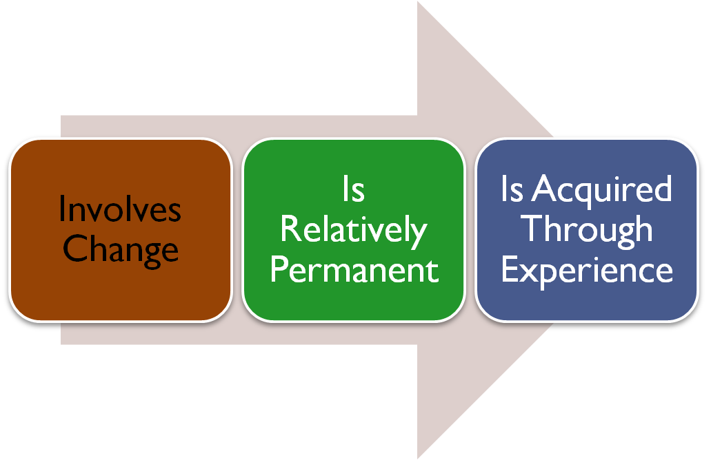
Learning
Learning is any relatively observable permanent change in behavior that occurs as a result of experience
Learning components:
2-<number>

Slide 4
Theories of Learning
Classical Conditioning
  A type of conditioning in which an individual responds to some stimulus that would ordinarily produce such a response.
Operant Conditioning
  A type of conditioning in which desired voluntary behavior leads to a reward or prevents a punishment.
Social-Learning Theory
  People can learn through observation and direct experience.

Slide 5
Classical Conditioning
Key Concepts:
  Unconditioned stimulus Food
    Pavlov’s Dog Drool
    A naturally occurring phenomenon.
  Unconditioned response
    The naturally occurring response to a natural stimulus.
  Conditioned stimulus
    An artificial stimulus introduced into the situation.
  Conditioned response
    The response to the artificial stimulus.
This is a passive form of learning. It is reflexive and not voluntary – not the best theory for OB learning.

Slide 6
Operant Conditioning
B. F. Skinner’s concept of Behaviorism: behavior follows stimuli in a relatively unthinking manner.
Key Concepts:
  Conditioned behavior: voluntary behavior that is learned, not reflexive.
  Reinforcement: the consequences of behavior which can increase or decrease the likelihood of behavior repetition.
  Pleasing consequences increase likelihood of repetition.
  Rewards are most effective immediately after performance.
  Unrewarded/punished behavior is unlikely to be repeated.

Slide 7
Social-Learning Theory
Based on the idea that people can also learn indirectly: by observation, reading, or just hearing about someone else’s – a model’s – experiences.
Key Concepts:
  Attentional processes
    Must recognize and pay attention to critical features to learn.
  Retention processes
    Model’s actions must be remembered to be learned.
  Motor reproduction processes
    Watching the model’s behavior must be converted to doing.
  Reinforcement processes
    Positive incentives motivate learners.

Slide 8
4 Factors of Observational Learning
Attention – Learners must attend to the model.
Retention – Learners must retain the behavior.
Production – Learners attempt to produce the behavior.
Motivation – Desire to reproduce the behavior.

Slide 9
Shaping: A Managerial Tool
Systematically reinforcing each successive step that moves an individual closer to the desired response.
Four Methods of Shaping Behavior:
  Positive reinforcement
    Providing a reward for a desired behavior (learning)
  Negative reinforcement
    Removing an unpleasant consequence when the desired behavior occurs (learning)
  Punishment
    Applying an undesirable condition to eliminate an undesirable behavior (“unlearning”)
  Extinction
    Withholding reinforcement of a behavior to cause its cessation (“unlearning”)

Slide 10
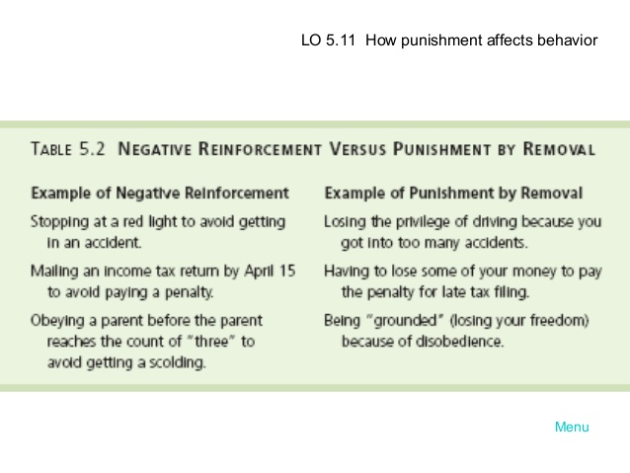

Slide 11
Schedules of reinforcement: A Critical Issue
Two Major Types:
  Continuous Reinforcement
    A desired behavior is reinforced each time it is demonstrated
  Intermittent Reinforcement
    A desired behavior is reinforced often enough to make the behavior worth repeating but not every time it is demonstrated
    Multiple frequencies

Slide 12
Types of Intermittent Reinforcement
Ratio
  Depends on the number of responses made.
Interval
  Depends on the time between reinforcements.
Fixed
  Rewards are spaced at uniform time intervals or after a set number of responses.
Variable
  Rewards that are unpredictable or that vary relative to the behavior.

Slide 13
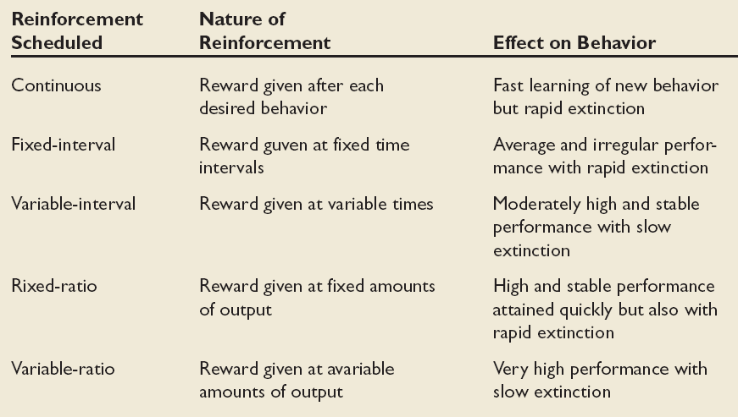
Schedules of Reinforcement
Fixed-ratio

Slide 14
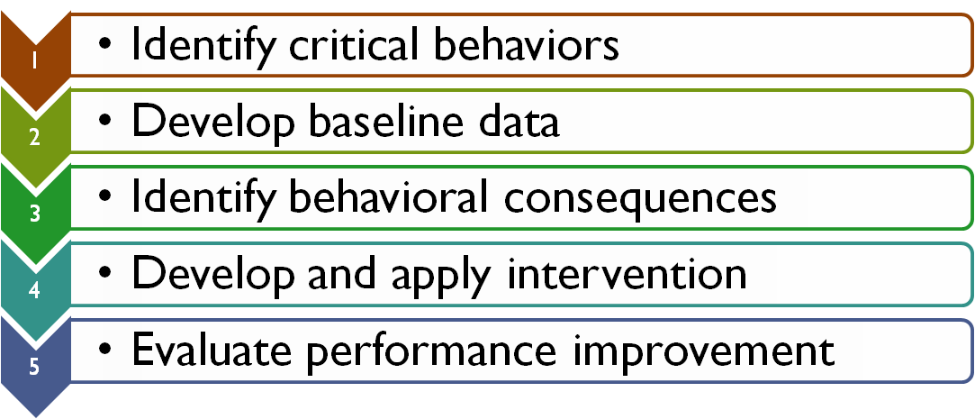
Behavior Modification (OB Mod)
The application of reinforcement concepts to individuals in the work setting
Follows the Five-Step Problem-Solving Model

Slide 15

Problems with OB Mod and Reinforcement
  Learning
    Observable change in behavior = learning.
    Positive Reinforcement works better than punishment.
Stimuli may not be consciously given as a means of shaping behavior.
Modern managers and OB theorists are using cognitive approaches to shaping behavior.

